Slide 1


Official Theme Song
Welcome to VJDY!
Roland GM
VJDY OFFICIAL
MUSIC STORE

Slide 2
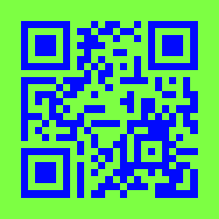
Download the Music to use in your videos at
bit.ly/VJDYMusicStore and Download the App

